Slide 1

Mode identification with CoRoT and Kepler solar-like oscillation spectra
Patrick Gaulme
Thierry Appourchaux
Othman Benomar

Slide 2
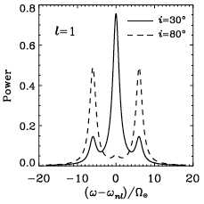
Spectral information
Global parameters
amplitude and maximum amplitude frequency
large spacing, small spacing
splitting and inclination
Mode parameters
frequency, height, width
Global fitting
global parameters : splitting, inclination
overlapping between modes
Gizon & Solanki 2003

Slide 3
Spectral information
Power density spectrum statistics
each frequency bin: χ² statistics with 2 degrees of freedom
Frequentist approach
maximum likelihood estimator (MLE)
model for which the data set probability is maximum
likelihood: L = P(D|λ,Ι) = Π_{i} [1/S₀(ν_{i})] exp[-S_{i}/S₀(ν_{i})]
Bayesian approach
restrict our imagination: a priori information
P(λ|D,Ι) = P(λ|Ι) P(D|λ,Ι)/P(D|Ι)

Slide 4
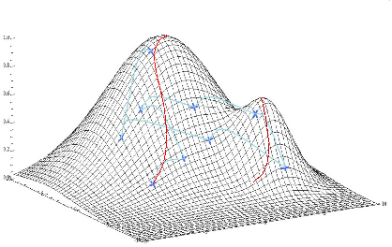
Bayesian approach
Posterior probability
find the maximum of P(λ|Ι) P(D|λ,Ι) is enough to estimate the parameters, but the model probability (normalization term P(D|Ι))
Gaussian prior
P(λ|Ι) = exp[-(λ – λ_{prior})²/σ²_{prior}]
Minimization of l = - log L_{MLE} + ∑_{λ} [(λ – λ_{prior})²/σ²_{prior}]
easy to implement
MAP: local maxima from the input, in the prior range
MCMC: extracts the global shape of the posterior probability
Likelihood
Parameter 2
Parameter 1

Slide 5
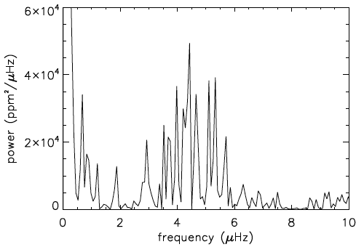
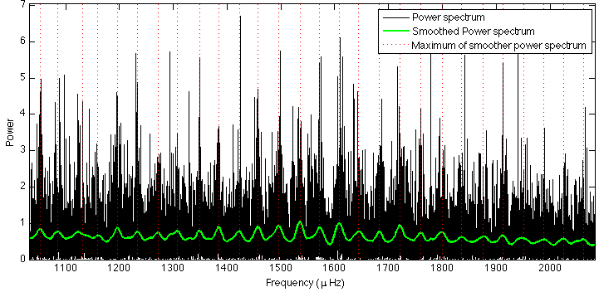
Bayesian approach
Inclination
rotation-activity relationship (Noyes et al. 1984)
V sin i on spectrometric measurements
Splitting
rotation-activity relationship
low frequency signature in the light curve power spectrum
Frequency
from the smoothed power spectrum
Height
about 1/7 of the maximum value of the power spectrum, for a given frequency

Slide 6
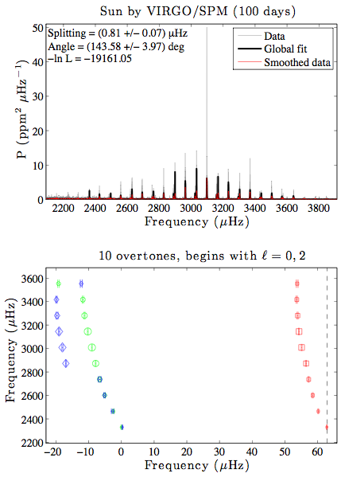
Global fitting with MLE/MAP
100-days of VIRGO/SPM data
MLE estimator with no a priori information
inputs: inclination = 45°, splitting = 1 µHz
output: splitting = 0.81±0.07 µHz, inclination = 143±4°
Bayesian approach is implicit
prior on inclination or splitting
output: 0.41 µHz

Slide 7
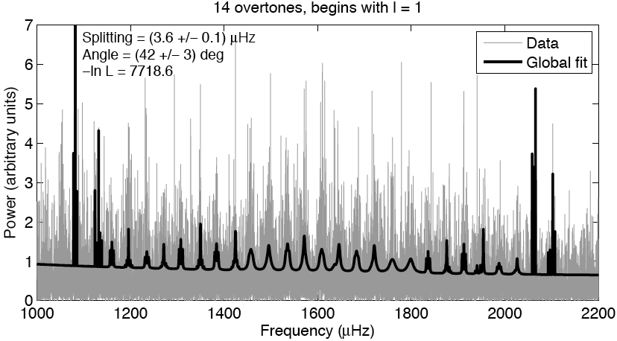
Global fitting with MLE
CoRoT data HD 49933

Slide 8
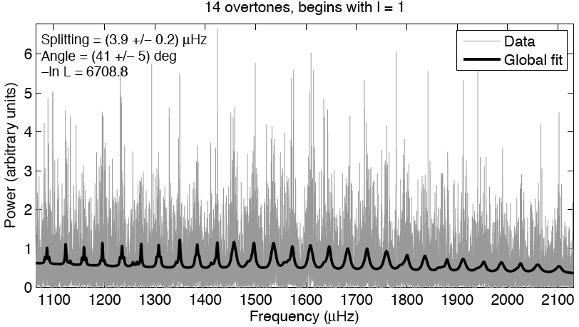
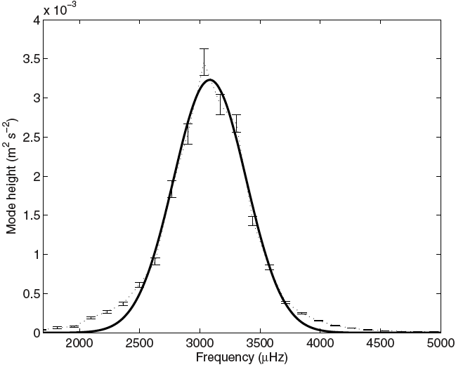
CoRoT HD 49933 with MAP
Height: Gaussian mode approximation (Gaulme et al. 2009)
H(ν) = H₀ exp[-(ν – ν₀)/2σ²]
Gaulme et al. 2009

Slide 9
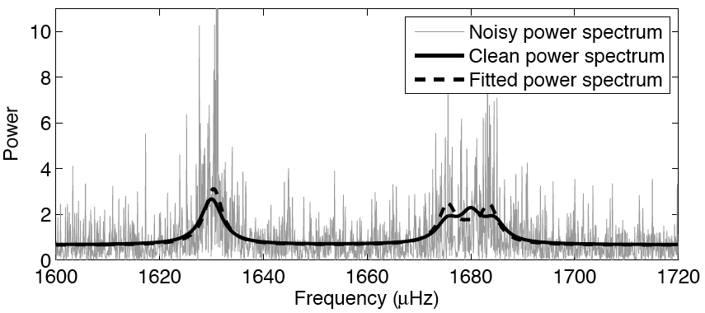
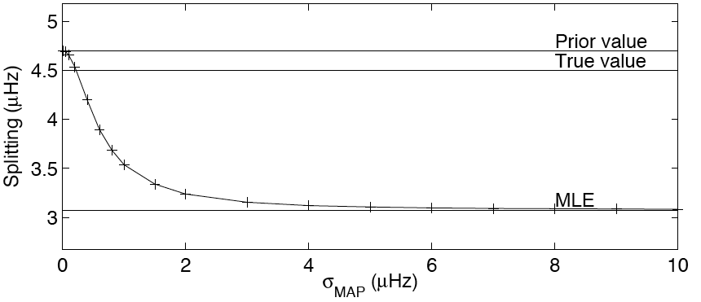
Careful with that MAP Eugene
Gaulme et al. 2009

Slide 10
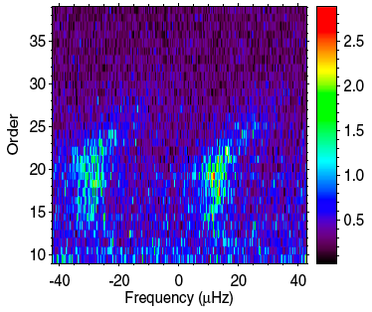
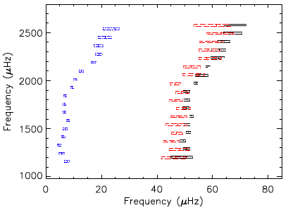
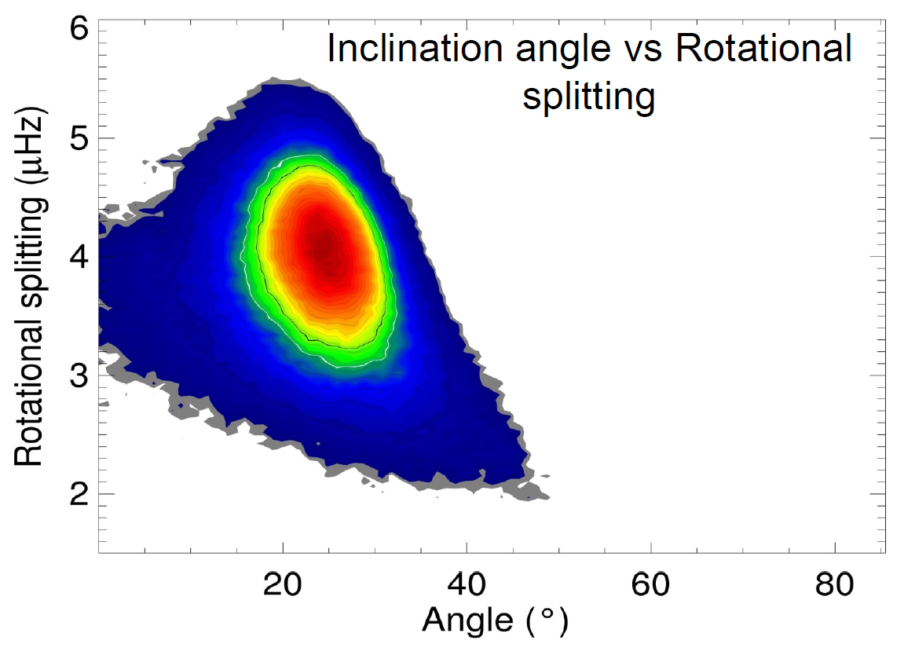
CoRoT HD 49933 with MCMC
Mode identification impossible in the Echelle diagram ➔ Probability calculation with MCMC:
Probability = 89% if the relative heights of the modes are not fixed
Probability > 99.999% if the relative heights are fixed to the solar values
Results confirmed with MLE and MAP
Angle/splitting correlated
Benomar et al. 2009

Slide 11
MCMC vs MAP
MCMC
MAP
No trapping in local minima
Time consuming
3 weeks with 1 CPU for a 60-day time series with 18 overtones
Straightforward error estimate of the fitted parameters
The solution depends on the initial guess
Fast to fit
few hours with 1 CPU, for a 60-day time series with 18 overtones
Non trivial error estimation: Hessian calculation

Slide 12
Dealing with massive data flux
Kepler data: 1500 Solar-like light curves
Large variety of “species”
Solar analogues
sub-giants
Large variety of spectra
plenty of mixed modes
120 stars to fit
MCMC: 7 years to fit the data with 1 CPU !
Step by step approach
global parameters: ν_{max}, ∆ν₀, δν (autocorrelation)
MLE/MAP with solar analogues
simplified MLE/MAP when mixed modes
MCMC for peculiar cases

Slide 13
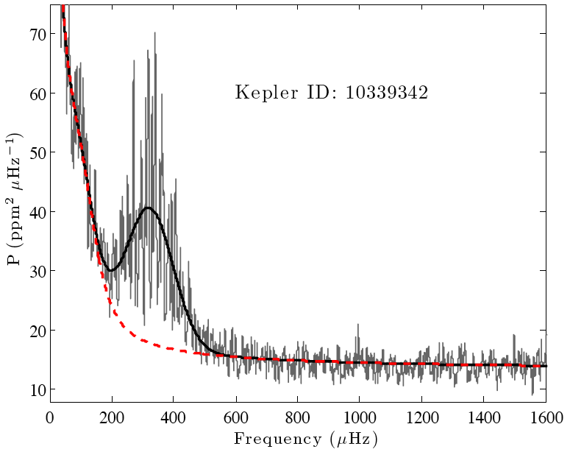
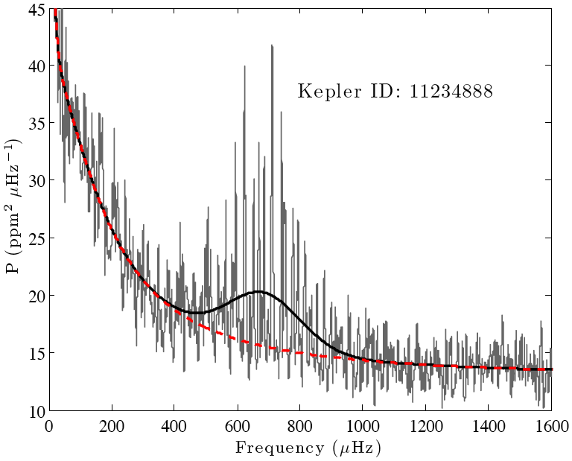
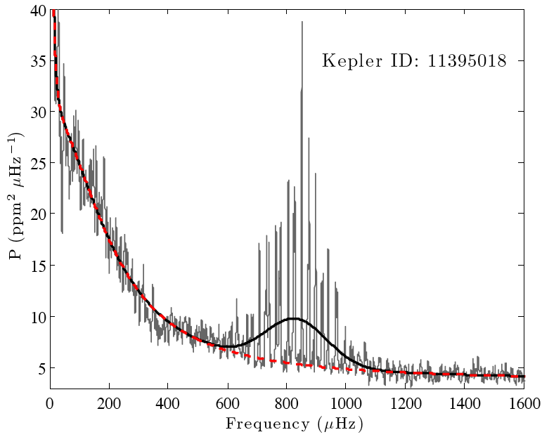
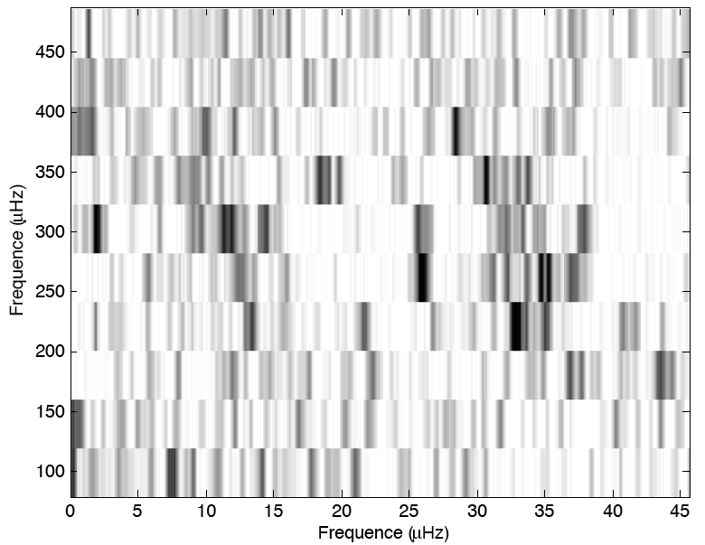
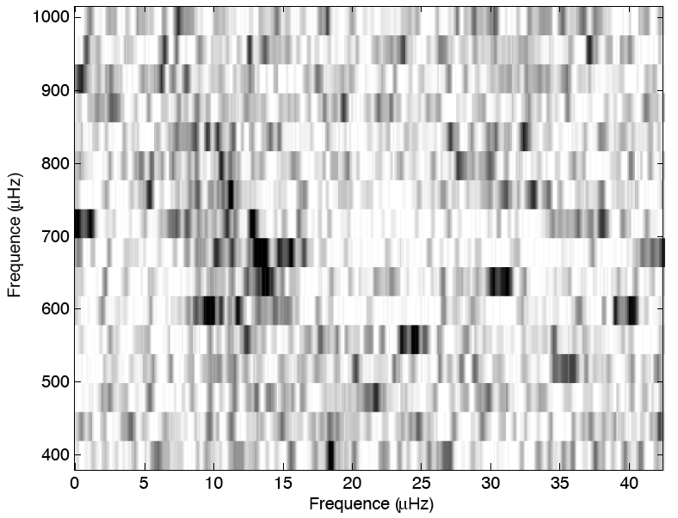
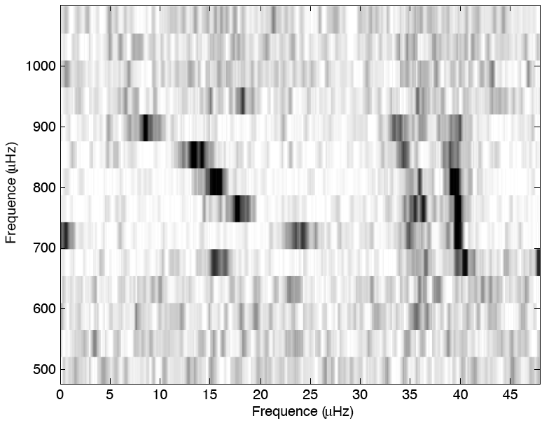
Dealing with massive data flux

Slide 14
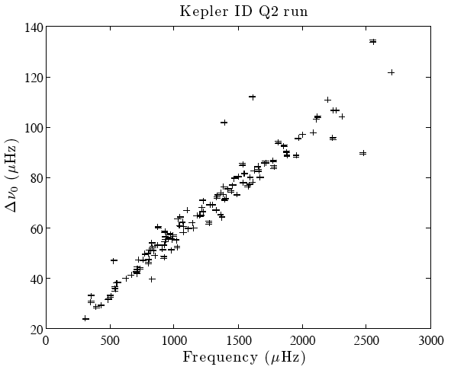
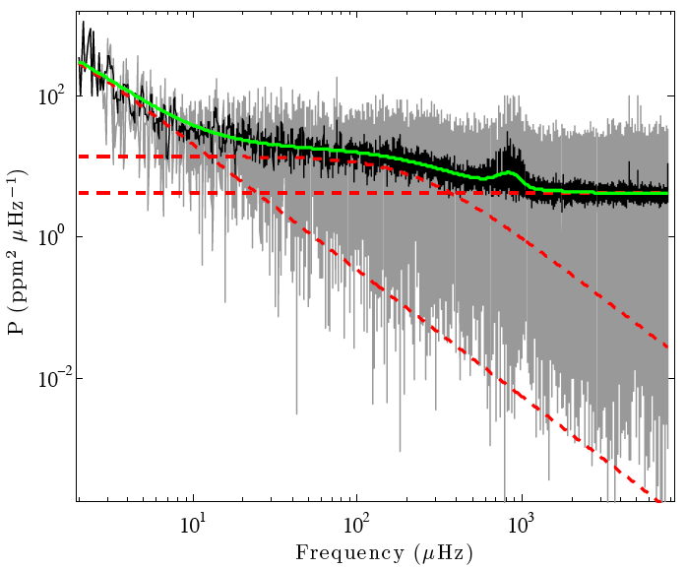
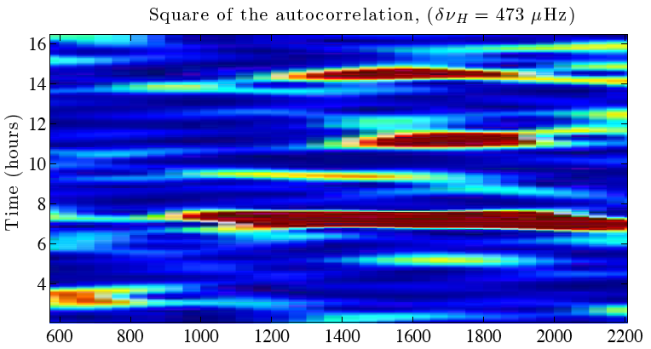
Fitting a massive data flux
Spectrometric information
Autocorrelation of time series
Background fitting
Roxburgh 2009, Mosser & Appourchaux 2009
∆ν_{0,*}/∆ν_{0,sun} = (M*/M_{sun})^{1/2} (R*/R_{sun})^{-3/2}
ν_{max,*}/ν_{max,sun} = (M*/M_{sun}) / [(R*/R_{sun})² (T*/T_{sun})]
HR-like diagrams, e.g.
- ∆ν₀ = f(ν_{max})
- δν = f(∆ν₀₎

Slide 15
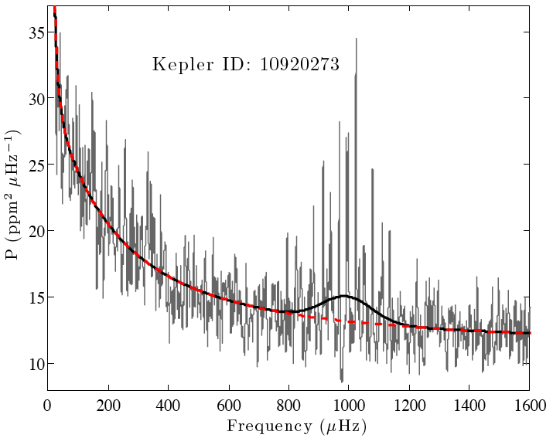
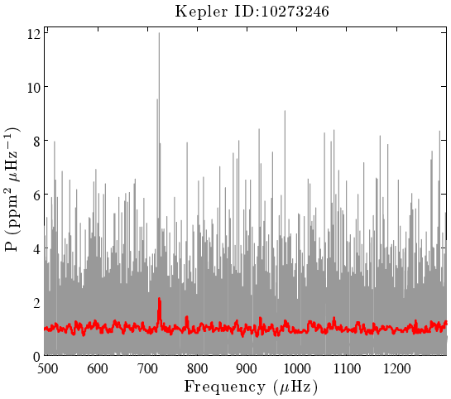
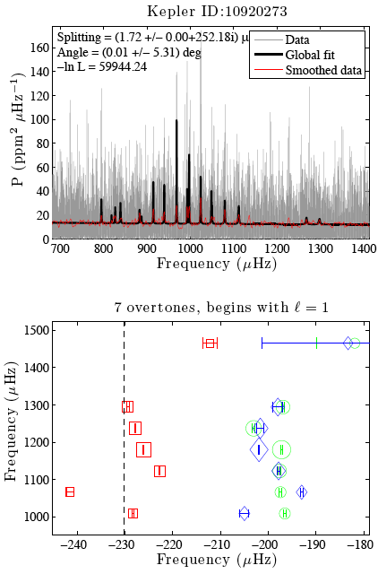
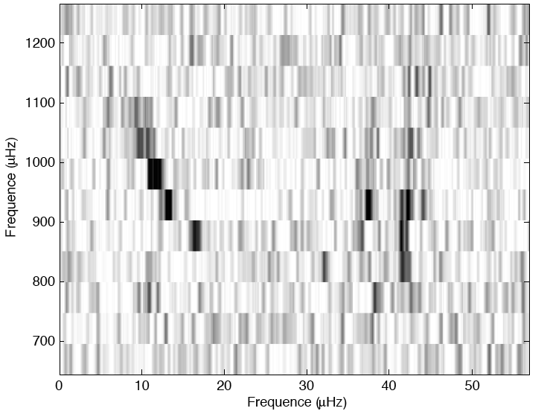
Fitting a massive data flux
Spectrometric information
Autocorrelation of time series
Background fitting
Global fitting with 2 scenarii
Global fitting with no splitting no inclination
Division by the best fit: mixed modes

Slide 16
Conclusion
CoRoT: 1-2 solar-like targets per 5-month run
accurate study of individual cases
Kepler: 100 solar-like targets per 1-month run
statistical study of global parameter
accurate study of peculiar cases
Several years to exploit the whole information

Slide 17
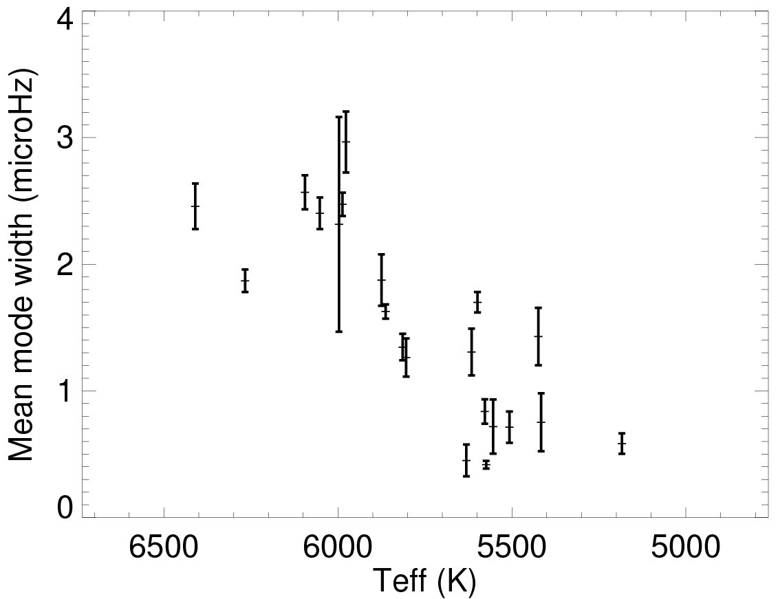
Gamma-T

