Slide 1
The evolved solar-type star
KIC 11026764 (Gemma)
Gülnur Doğan, Aarhus University
Michael Thompson, Univ. of Sheffield / HAO, NCAR
and the KASC WG#1

Slide 2
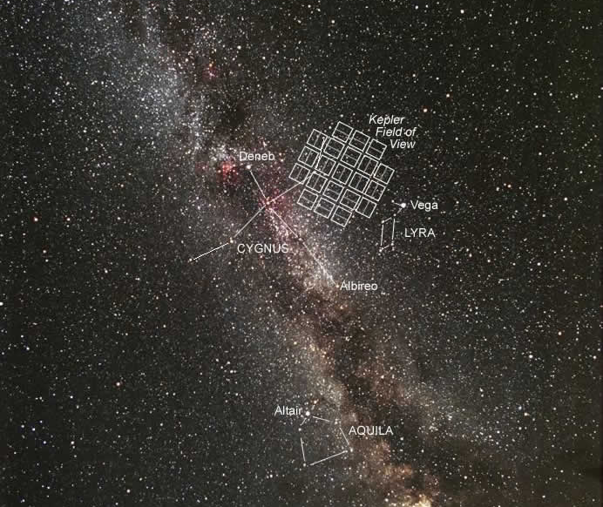

Slide 3
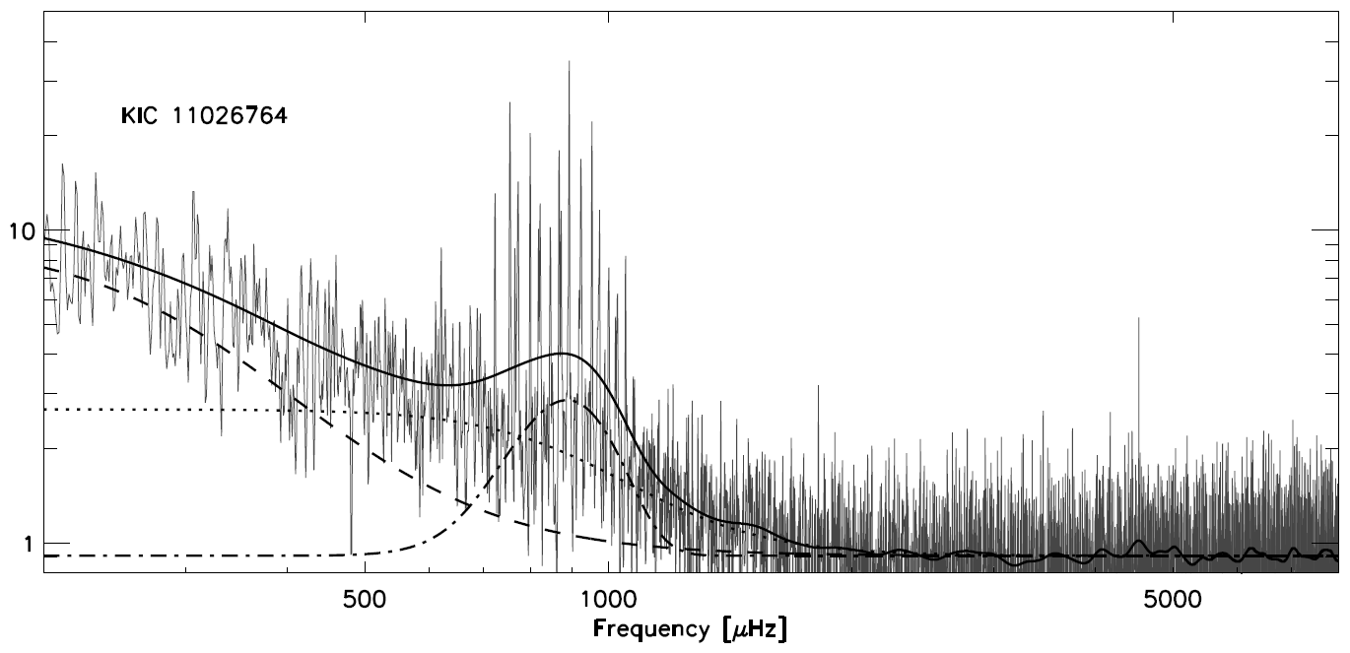
Power spectrum
Chaplin et al. 2010, ApJ Letters 713, L169

Slide 4
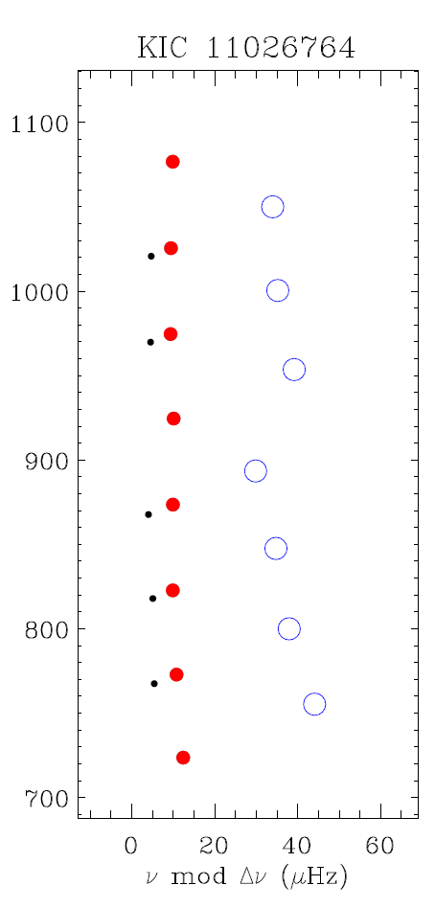
Echelle Diagram
Chaplin et al. 2010, ApJ Letters 713, L169

Slide 5
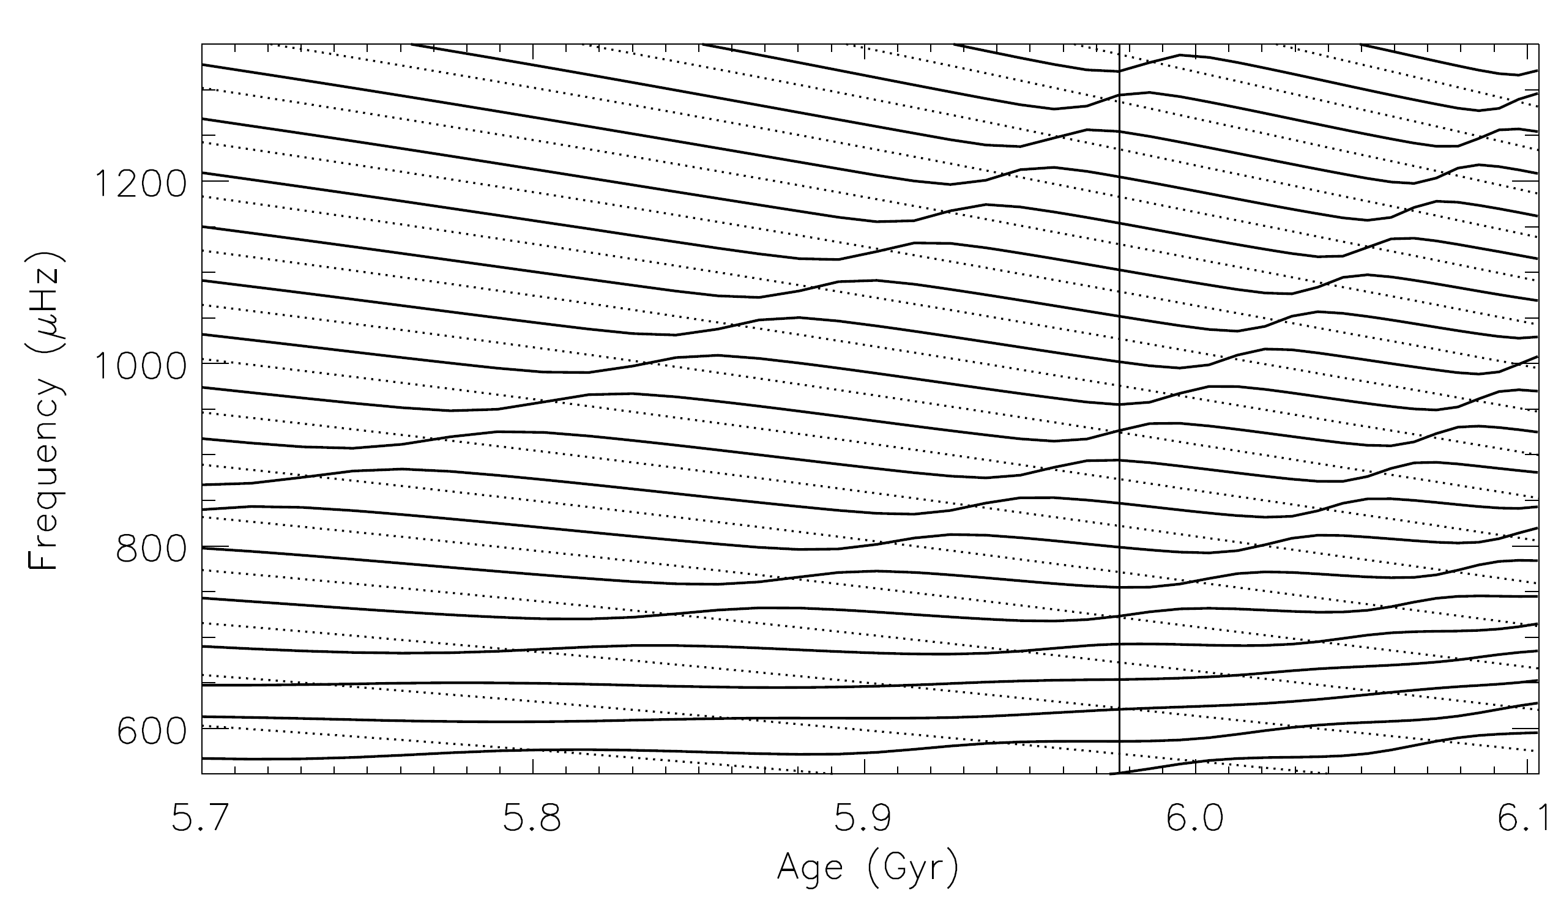
Mixed modes
Metcalfe et al. 2010

Slide 6
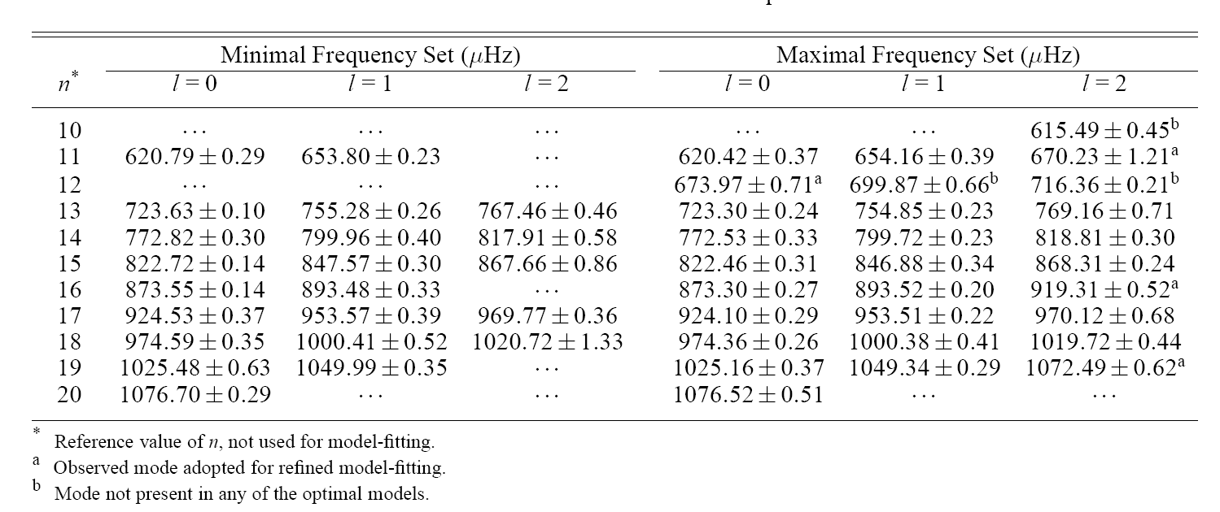
Frequency analysis
8 teams, several methods
Metcalfe et al. 2010

Slide 7
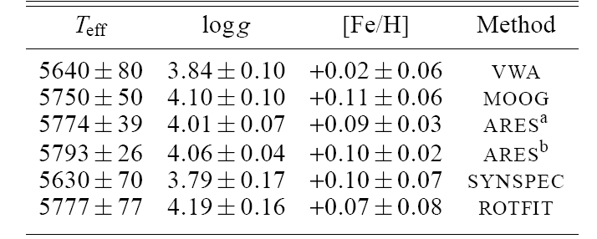
Atmospheric parameters for KIC 11026764 (through high-resolution spectroscopy)
We adopted for the initial analysis:
T_{eff} = 5635 ± 185 K
logg = 3.95 ± 0.25 dex
[Fe/H] = -0.06 ± 0.25 dex
Metcalfe et al. 2010

Slide 8
Several modelling methods
Pipeline analysis using large and/or small frequency separations
Fitting the individual frequencies using pipeline approach
Fitting the individual frequencies “by hand”
+
Freedom in the input physics

Slide 9
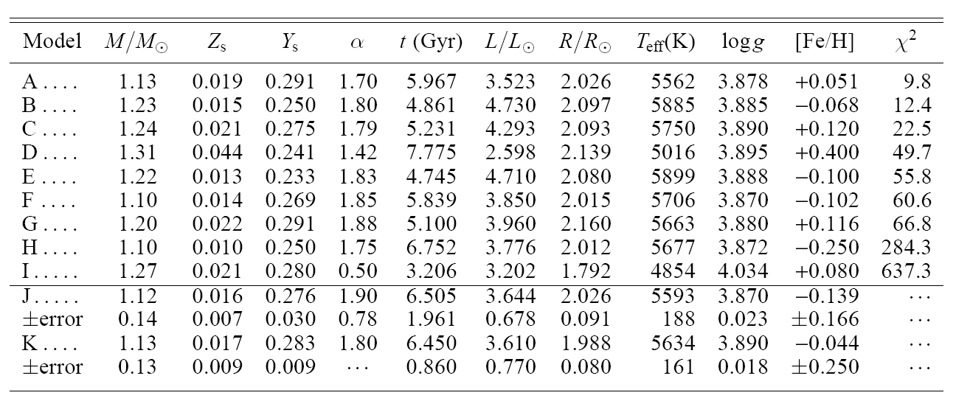
Initial model-fitting search for KIC 11026764...
Metcalfe et al. 2010

Slide 10
Initial model-fitting search for KIC 11026764...
A – ASTEC
B – Geneva
C – GARSTEC
D – AMP(ASTEC)
E – YREC
F – GARSTEC
G – ASTEC
H – DSEP
I – CESAM
J – SEEK(ASTEC)
K – RADIUS(ASTEC)
Metcalfe et al. 2010

Slide 11
Initial model-fitting search for KIC 11026764...
… resulted in 2 families of solutions.
Metcalfe et al. 2010

Slide 12
Initial model-fitting search for KIC 11026764...
Metcalfe et al. 2010

Slide 13
Initial model-fitting search for KIC 11026764...
Metcalfe et al. 2010

Slide 14
Initial model-fitting search for KIC 11026764...
Metcalfe et al. 2010

Slide 15
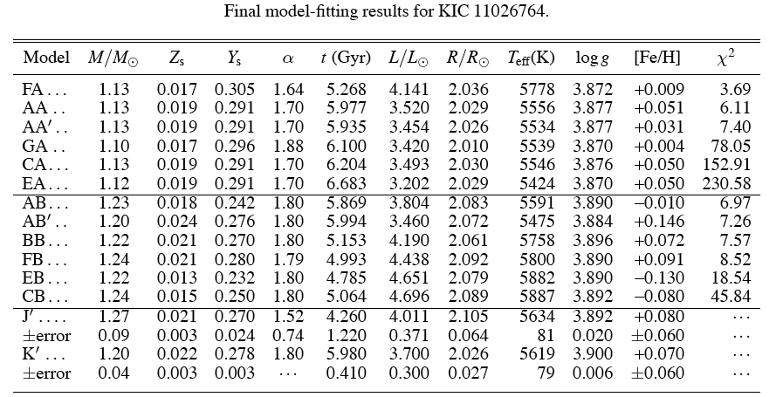
Final model-fitting results for KIC 11026764...
Metcalfe et al. 2010

Slide 16
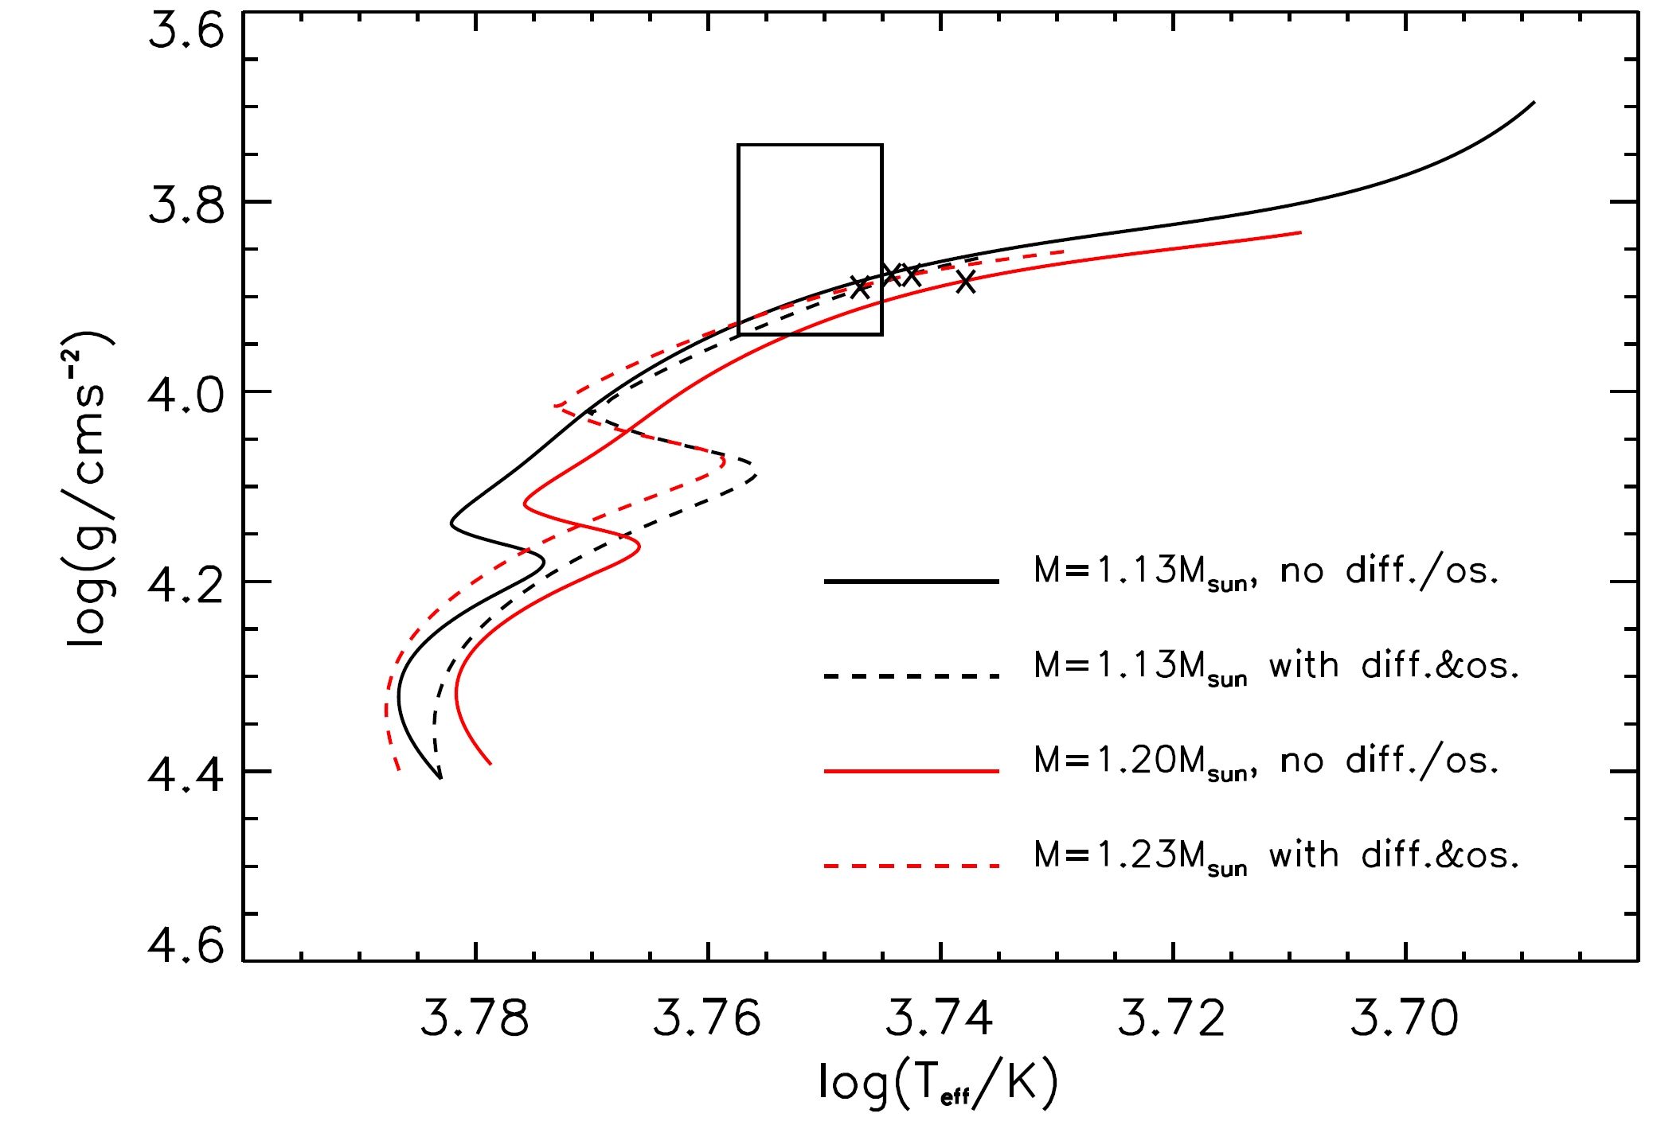
log(g)-T_{eff} diagram showing two possible families

Slide 17
Final model-fitting results for KIC 11026764...
Metcalfe et al. 2010

Slide 18
Echelle diagrams comparing observed and model frequencies

Slide 19
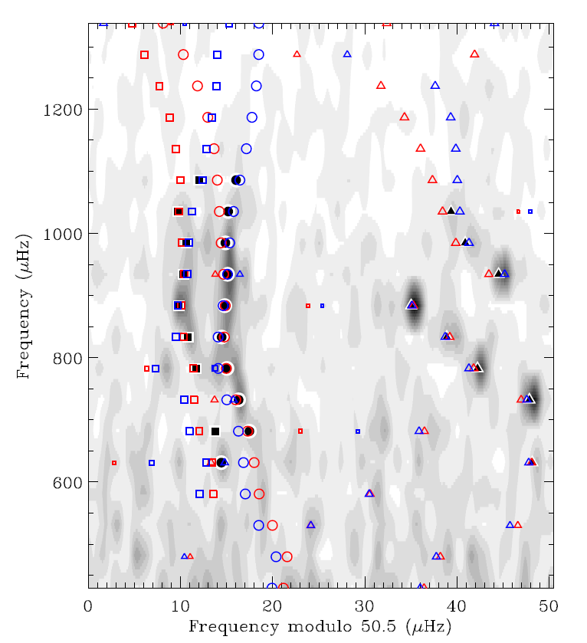
Echelle diagram comparing observed and model frequencies
Metcalfe et al. 2010

Slide 20
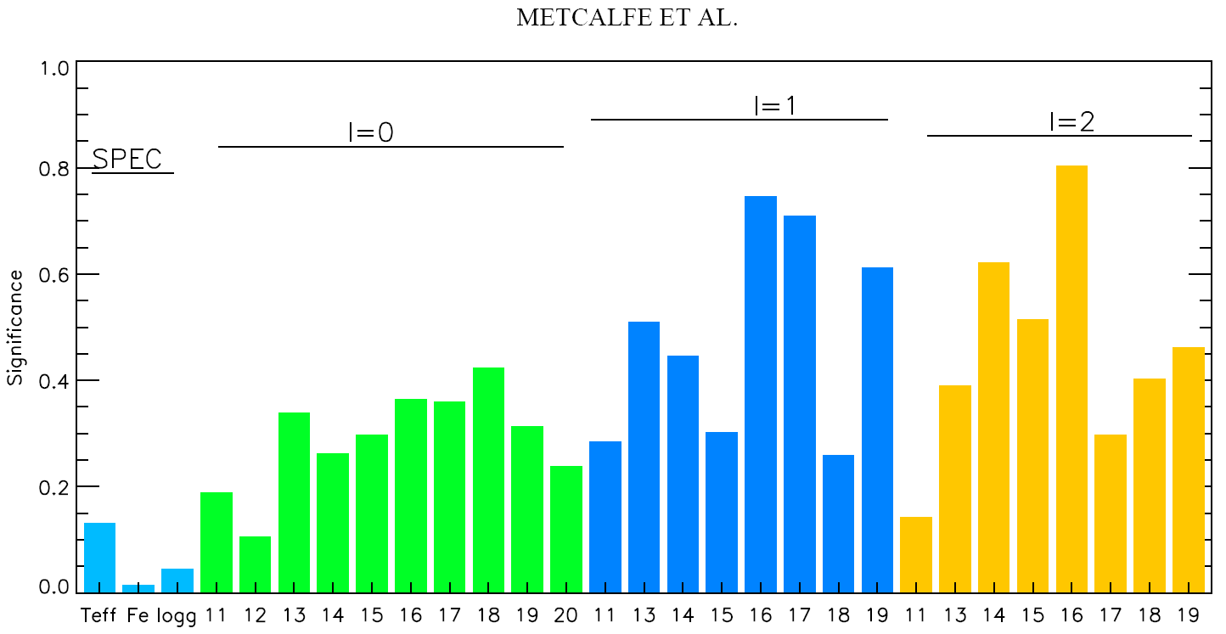
Significance of observable constraints
Metcalfe et al. 2010

Slide 21
Final parameter estimates
Model-dependent
Age = 5.94 ± 0.05 Gyr
R = 2.05 ± 0.03 R_{sun}
L =3.56 ± 0.14 L_{sun}
+ systematic errors
10 % ambiguity in stellar mass:
2 families with ~1.1M_{sun} and ~1.2M_{sun}

Slide 22
Conclusions
Precision in the age determination is an order of magnitude improved over pipeline results (importance of individual frequencies).
Radius is determined with a precision compatible to or slightly better than that of the pipeline results.
Same methods apply to planet-host stars.
Ambiguity of the mass is to be removed by tighter/additional seismic constraints OR by a direct measurement of luminosity.

Slide 23
Power-law correction for near-surface deficiencies (Kjeldsen et al. 2008)

Slide 24
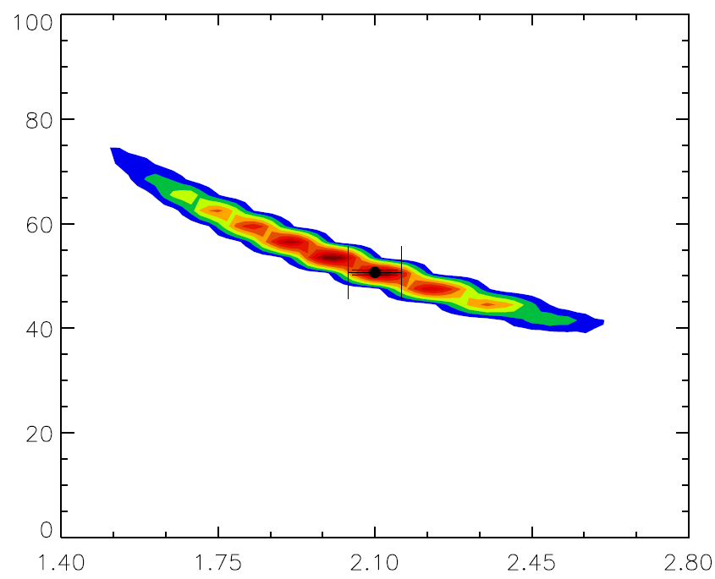
Normalized probability distribution showing the correlation of the radius with characteristic separations
Δν (μHz)
R (R_{sun})
Metcalfe et al. 2010

